Slide 1
SDV602 MILESTONE 2
PPT-Video Presentation
ACHUTHANAND VASUDEVAN

Slide 2
WHAT IS GOING TO DISCUSS
Domain Classes
SQLite Database
What SQLite database
Pros and Cons of SQLite
Data Service Class
Purpose of Data Service Class
Commonly used inbuilt methods

Slide 3
Domain Classes
Domain classes are used to define what tables are required for the implementation.
Required Domain Classes
User
GameData
UserGameData
SceneData
ChatDetails
Annotations used to defined fields in Domain classes
Primary Key - to define primary key
AutoIncrement - to define a column that increments as new row is added.
MaxLength – to define the maximum length
NotNull – to define the column not allowed to be null
Column – to define the column name, datatype and order
There are many other annotation. But these are most commonly used ones

Slide 4
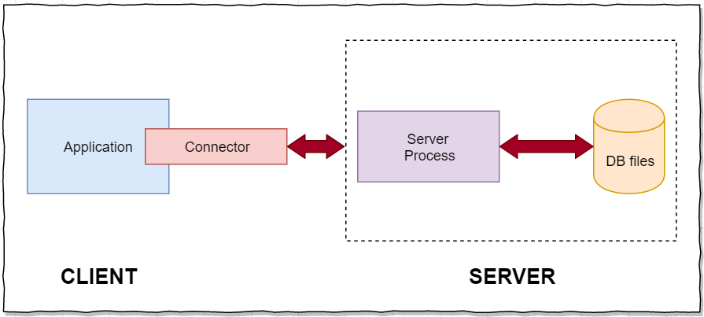
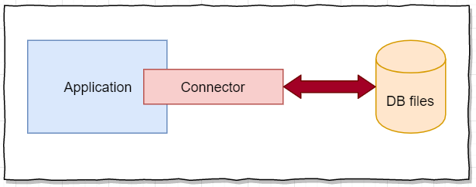
SQLite Database
SQLite is a library that implements small, fast, self-contained, high-reliability, full-featured serverless SQL database engine
Serverless SQLite Architecture
RDBMS Client/Server Architecture

Slide 5
Advantages
Light Weight database
Self contained
Requires only minimal support
Support embedded environments
Phones
Game consoles
Zero configuration
Serverless architecture. Hence no config files required
Dynamic data types
No installation required
Compatible with all languages
Portable – supports both 32 and 64 bit
Better performance
Reading and writing is faster
Loads only required data
Dis-Advantages
Will be deleted when app is uninstalled
If file storage on internal memory, which also gets deleted on app uninstall
If file storage on external memory, is open for access by any other applications
It’s slow (no caching mechanism)
In most cases database size restricted to 2GB
Not scalable

Slide 6
DatA Service class
DataService class is used to connect the application with SQLite database. The required database will be created when constructor of DataService class is invoked. The database is created only when no database exists. Also all the tables will be created if required and base game data will be inserted.
Commonly Used SQLite Functions
CreateTable – Create defined table if not exists
Insert – Insert a single new row
InsertAll – Insert a list of new rows
Update – Update a single row with change in data
UpdateAll – Update a list of passed data rows with change in data
Delete – Deletes a single row
DeleteAll – Deletes a list of passed rows
Get – To retrieve data from database by passing key or conditions
Find – Same as Get function
There are other methods such as Query, DefferedQuery to execute custom queries which will be required in complex situations.

Slide 7


